Slide 1
Food and Beverage Management The sixth edition
Chapter 10
Making Strategic Decisions

Slide 3
Chapter 10 covers:
The origins of strategy
Assessing current performance
Assessing organisational capability
Strategic analysis and planning
The need for a balanced approach
The basis of strategy
Strategic direction and strategic means
Evaluation criteria

Slide 4
Origins of strategy
Strategic decisions:
Affect the direction to which an organisation is committed for the next few years
Involve a significant commitment of resources
Involve complex situations at corporate, business unit and operational

Slide 5
Terms used include:
Vision
Mission
Policy
Goals/aims
Strategy
Objectives
Tactics

Slide 6
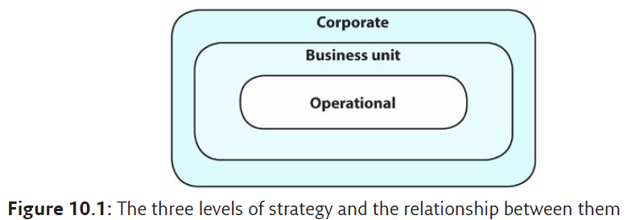
The three levels of strategy

Slide 7
Assessing current performance
Same three levels used when assessing the performance of the current operation:
Operational
includes day-to-day sales and the way the product is provided and promoted
Business
the performance of the enterprise in terms of profitability, competitiveness and other business measures
Corporate
the strategic direction of the operation and how this is being achieved

Slide 8
Assessing current performance
Includes:
Quantitative analysis
Business environment analysis
Qualitative evaluation

Slide 9
Quantitative analysis
Essential part of appraisal
Considered over time
Evaluation is more important than the data itself

Slide 10
Quantitative analysis can:
Identify trends and progress
Enable comparisons with the competition and the industry as a whole
Reveal lost profit and growth potential
Identify areas needing improvement
Highlight and emphasise possible danger areas

Slide 11
Ratio analysis
Includes:
Operational ratios
Activity ratios
Profitability ratios
Liquidity ratio
Gearing ratios
Stock market ratios
Social media and marketing
The formulae and explanations of what the indi­vidual ratio can indicate, are detailed in Appendix A Food and Beverage Management 6th edition, Cousins et. al. 2022

Slide 12
Quantitative measures
Have the potential to draw attention only to things that can be easily measured
Performance indicators measure behaviour, but can also change behaviour to only satisfy the indicator
Some of the indicators are prone to being manipulated to give the impression of higher quality than is actually being achieved

Slide 13
Quantitative evaluation
Should be used as an additional tool to back up issues identified in another area of analysis
Evaluation of the quantitative analysis is more important than figures themselves
Quantitative evaluation supports:
Making informed evaluation of the business
Allowing for external comparison
Ensuring the right questions are asked

Slide 14
Business environment appraisal
Two main approaches:
Macro-environment
PESTLE
Micro-environment
Porter’s Five forces

Slide 15
The business macro-environment
P Political
E Economic
S Socio-cultural
T Technological
L Legal
E Ecological (environmental)

Slide 16
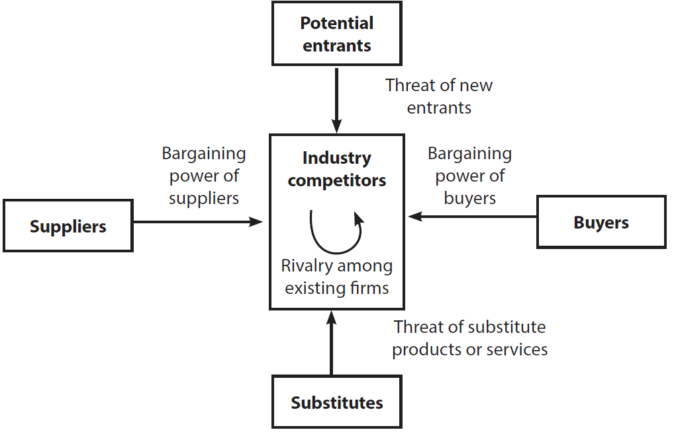
The business micro-environment
Porter’s Five Forces
Adapted from Porter 2004

Slide 17
Porter’s Five Forces
Industry competitors are food service businesses that are in direct competition
Potential entrants are the new organisations, which may threaten the business of existing organisations
Suppliers to the business can have bargaining power
Buyers have power to affect the business
Substitutes are alternative products which the buyers might choose instead of the food service operations product

Slide 18
Qualitative evaluation
Evaluation takes account of the quantitative analysis and the appraisal of the macro and micro business environment
Qualitative evaluation can lead to informed views on a variety of aspects of the business

Slide 19
Qualitative evaluation
Includes monitoring the effectiveness of:
The service specification
Processes and procedures
Quality control and quality assurance
Use of equipment
Staffing
Current and future capability

Slide 20
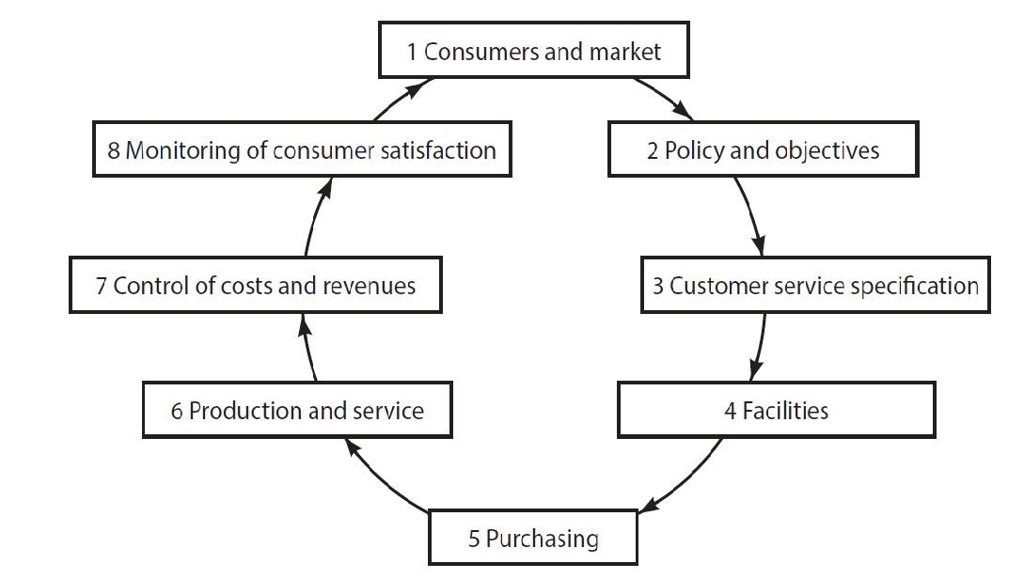
Analysis using the Food Service Cycle

Slide 21
The Food Service Cycle
Difficulties in one element of the cycle will cause difficulties in the elements of the cycle that follow
Difficulties experienced under one element of the cycle will have their causes in preceding elements

Slide 22
External comparison
With other organisations generally
With other similar organisations
Against industry norms
Through benchmarking

Slide 23
Assessing organisational capability
Resource analysis
How well do we do what we do?
Existing capacity for change
Identifying changes in resources
Value chain analysis
Examine all stages of the food service cycle

Slide 24
Strategic analysis and planning
Seeks to manage the interface between:
The external environment
(opportunities and threats)
and
The internal capabilities of the operation
(strengths and weaknesses)

Slide 25
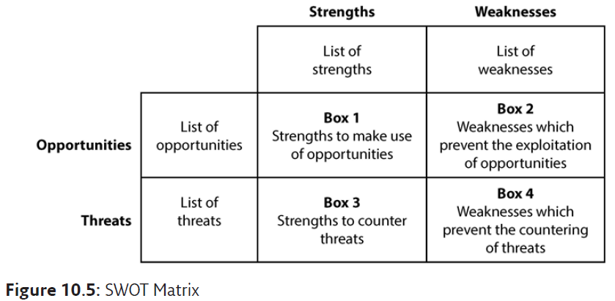
SWOT matrix

Slide 26
Using the SWOT analysis
Need for constant monitoring
Assess for now and the future:
What possible external changes might turn a current strength into a weakness, or vice versa?
How can current strengths be used to explore future opportunities?
Are current resource capabilities able to meet future demands?

Slide 27
Need for a balanced approach
Decision making must take account of four perspectives:
Developmental – organisational capacity, knowledge and innovation
Operational – efficiency
External – stakeholder and customer satisfaction
Financial – performance and financial management
Balanced Scorecard Institute

Slide 28
Balanced Scorecard
Organisations need to know:
how the Internal Drivers are contributing to the Results

Slide 29
Using the Balanced Score Card
Helps to:
Translate the mission statement into operational terms
Consider more than just financial outcomes
Look at causes, not just effects
Ensure a consistency of vision, and
Identify areas for improvement
But important to review if the measures being monitored are the right ones

Slide 30
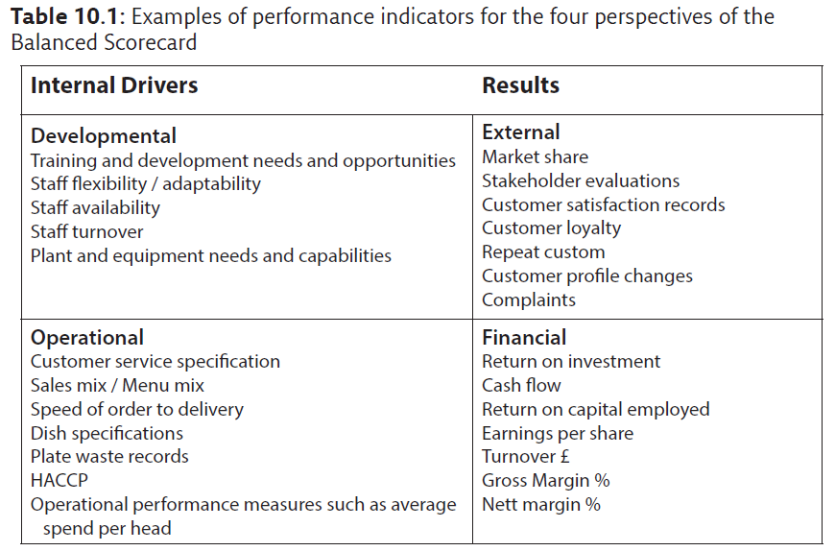
Examples of performance indicators

Slide 31
Strategy is a means to an end
“Would you tell me please which way I ought to go from here?” she asked.
“That depends a good deal on where you want to get to,”
said the cat.
Lewis Carroll, Alice’s Adventures in Wonderland (1865)

Slide 32
Strategy is a means to an end
Where do you want to get to? | Where are you starting from? | Which way ought you to go?
Objective | Current position | Strategy

Slide 33
Basis of strategy
1. Cost leadership
2. Differentiation
3. Focus
3a. based on cost
3b. based on differentiation
Michael Porter (2004a)

Slide 34
Porter’s matrix
Adapted from Porter 2004

Slide 35
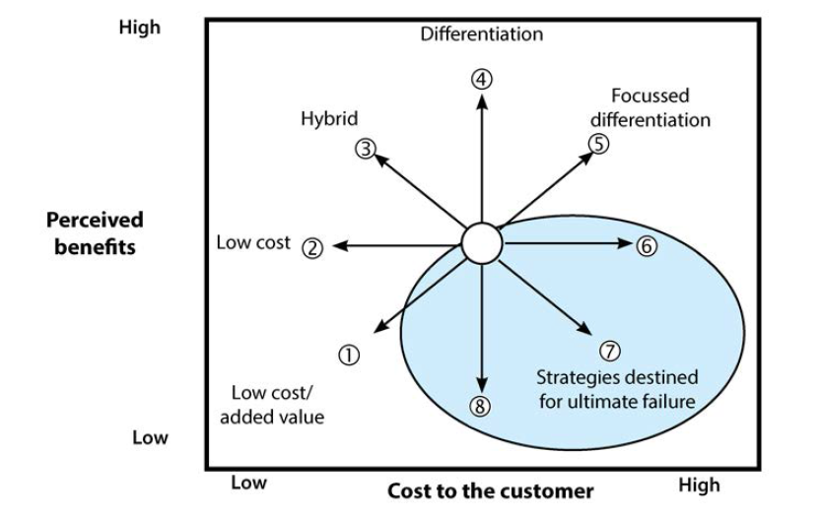
Strategy Clock
Eight possible
strategic routes
Adapted from Johnson et al. 2008 and 2017

Slide 36
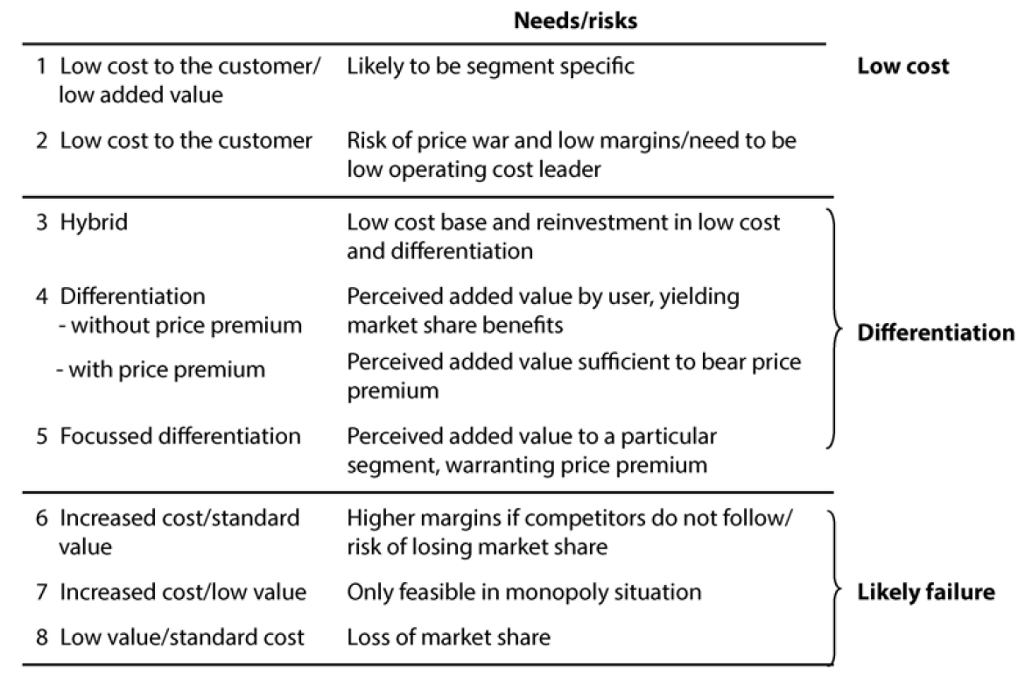
Eight possible strategic routes

Slide 37
Strategic direction
Various approaches can assist, including:
Growth Share (BCG) Matrix
Life cycle analysis
Ansoff’s growth matrix

Slide 38
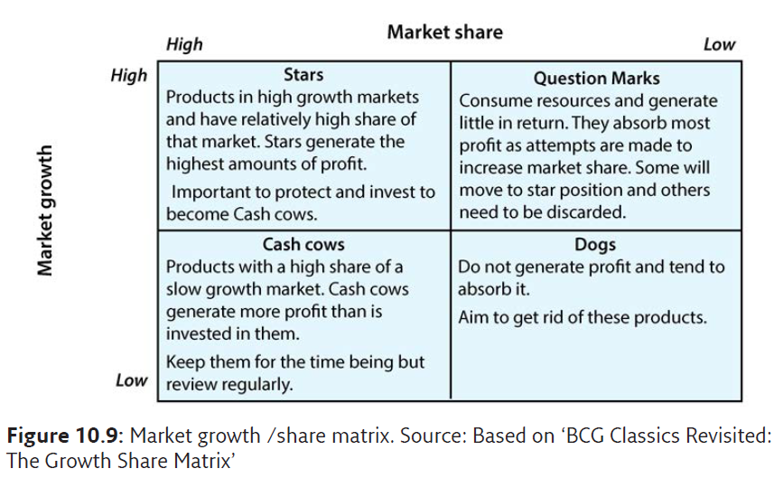
Product Portfolio Matrix

Slide 39
Life cycle analysis
Stages
Introduction – Growth – Maturity – Decline
Market position
Dominant – Strong – Favourable – Tenable – Weak
Variants
Fad life cycle
Extended life cycle

Slide 40
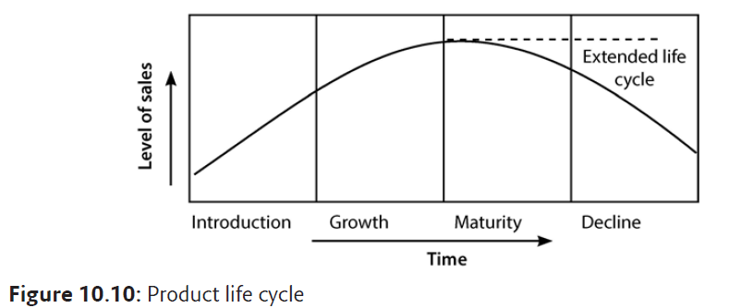
Life cycle analysis

Slide 41
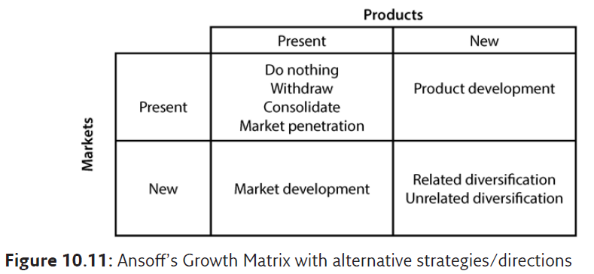
Ansoff’s growth matrix

Slide 42
Alternative strategies
Present market, present products:
What would be the implications of doing nothing? Is withdrawal feasible? Is consolidation or market penetration feasible?
Present market, new product:
What sort of new product could be developed for the present market?
New market, present products:
Has the organisation considered the scope for entering into new markets?
New markets, new products:
Does organisation have the capability to be successful with new products in new and unfamiliar markets?

Slide 43
Strategic means and assessing options
Strategic means
Internal development
Mergers and acquisitions
Joint development
Evaluation criteria for options
Suitability
Feasibility
Acceptability

Slide 44
Strategy and organisations
If approaches to strategic management were only undertaken in a scientific way, decisions would only be rational and objective
But organisations are complex, and decisions about strategy are largely dependant on the predominant organisational characteristics
This helps to indicate why similar food service businesses, facing similar business environments, might make quite different strategic decisions

Slide 45
The reality of strategic management
Organic not linear
Affected by organisation and culture
Complex and judgmental
Continuous process
Combines a variety of approaches and techniques
A management job
Based on a continuum of formulation and implementation
Needs to be flexible to cope with uncertainty

